Slide 1
DAYANANDA SAGAR COLLEGE OF ENGINEERING
Shavige Malleshwara Hills, Kumaraswamy Layout, Bengaluru 560111
DEPARTMENT OF MEDICAL ELECTRONICS ENGINEERNG
Internship Presentation – VIII Semester
21MD82
Name Adwin Justa Manuel | USN 1DS21MD004
Under the guidance of
Dr. Padma C. R.,
Associate Professor

Slide 2
Vision and Mission
VISION OF DEPARTMENT
To develop an excellent centre of progressive quality learning, applied & translational research through inventive collaborations and sustainable solutions to address healthcare related societal challenges
MISSION OF DEPARTMENT
By creating a conducive atmosphere for continuous learning through increased participation of students and faculty in various academic activities
By achieving needful and relevant healthcare solutions through quality education and research
By imparting education in the path of ethical and social responsibilities, to work effectively with diverse groups for the benefit of the society
VISION OF INSTITUTE
To impart quality technical education with a focus on research and innovation, emphasizing on development of sustainable and inclusive technology for the benefit of society
MISSION OF INSTITUTE
To provide an environment that enhances creativity and innovation in pursuit of excellence
To nurture teamwork in order to transform individuals as responsible leaders and entrepreneurs
To train the students to the changing technical scenario and make them to understand the importance of sustainable and inclusive technologies

Slide 3
Program Outcomes (POs)
Engineering Graduates will be able to:
Engineering Knowledge: Apply the Knowledge of Mathematics, Science, Engineering Fundamentals, and an Engineering specialization to the solution of complex Engineering problems
Problem Analysis: Identify, Formulate, Review research literature, and analyze complex engineering problems reaching substantiated conclusions using first principles of Mathematics, natural sciences and engineering sciences
Design/Development of solutions: Design solutions for complex engineering problems and design system components or processes that meet the specified needs with appropriate consideration for the public health and safety, and the cultural, societal, and environmental conditions
Conduct investigations on complex problems: Use research based knowledge and research methods including design of Experiments, analysis and interpretation of data, and synthesis of Information to provide valid conclusions
Modern tool usage: Create, select, and apply appropriate technique, resources, and modern engineering and IT tools including prediction and modelling to complex engineering activities with an understanding of the limitations
The Engineer and the world: Apply reasoning informed by the contextual knowledge to assess society, health, safety, legal and cultural issues and the consequent responsibilities relevant to the professional engineering practice
Ethics: Apply ethical principles and commit to professional ethics and responsibilities and norms of the engineering practice
Individual and team work: Function effectively as an individual, and as a member or leader in diverse teams, and in multidisciplinary settings
Communication: Communicate effectively on complex engineering activities with the engineering community and with society at large, such as, being able to comprehend and write effective reports and design documentation, make effective presentations, and give and receive clear instructions
Project management and finance: Demonstrate knowledge and understanding of the engineering and management principles and apply these to one’s work, as a member and leader in a team, to manage projects and in multidisciplinary environments
Lifelong learning: Recognize the need for, and have the preparation and ability to engage in independent and life-long learning in the broadest context of technological change

Slide 4
Program Educational Objectives (PEOs) and Program Specific Outcomes (PSOs)

Slide 5
CONTENTS
About Organization
Mentor
Introduction
Objectives
Internship task overview
Literature Review
Technologies used
Tasks Completed Till Date
References

Slide 6

ABOUT ORGANIZATION
Dayananda Sagar College of Engineering (DSCE) is a prestigious private engineering institution in Bangalore, India. Established in 1979 under the Mahatma Gandhi Vidya Peetha Trust. The college is affiliated with Visvesvaraya Technological University (VTU) and accredited by NBA and NAAC (A grade).
DSCE fosters a dynamic organizational structure with:
Governing Council & Academic Leadership: Led by experienced academicians and industry experts.
Departments & Research Centers: Dedicated faculty and state-of-the-art labs supporting research and learning.
Student Development & Industry Collaboration: Active student clubs, corporate partnerships, and placement cells ensure holistic growth.

Slide 7

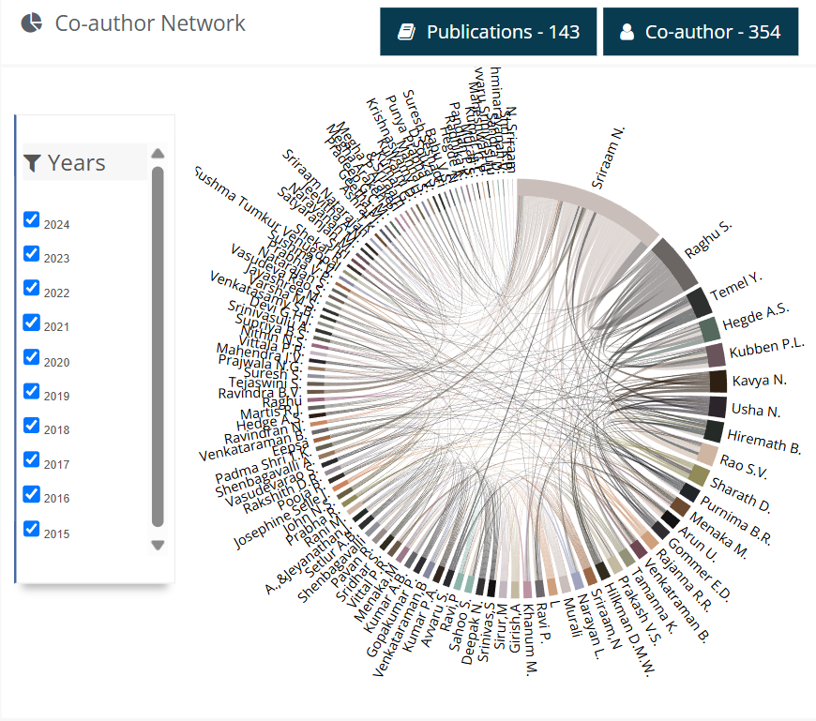
MENTOR
Dr. N. Sriraam has been an exceptional mentor for my internship on "Design and Development of Wireless Flexible Electronics Nasal Wiflen Mask for Respiratory Breathing Assessments." As Dean R&D and Professor in Medical Electronics Engineering, his expertise in wearable electronics and biomedical signal processing greatly enriched my research experience. With 26 years of research experience, he has made significant contributions through over 158 international journal publications, 146 conference papers, and multiple patents. His Vidwan profile score is 9.2 (https://vidwan.inflibnet.ac.in/profile/194352), reflecting his strong research impact.
DR. N. SRIRAAM
Dean R&D, Professor and HOD, Department of Medical Electronics Engineering
Fig2:Co-author Network of Mentor((https://vidwan.inflibnet.ac.in/profile/194352)

Slide 8
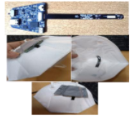
INTRODUCTION
“DESIGN AND DEVELOPMENT OF WIRELESS FLEXIBLE ELECTRONICS NASAL WIFLEN MASK FOR RESPIRATORY BREATHING ASSESSMENTS”
The Design and Development of Wireless Flexible Electronics Nasal Wiflen Mask for Respiratory Breathing Assessments is an innovative project aimed at developing a wearable, non-invasive respiratory monitoring system. This flexible electronics-based nasal mask integrates wireless sensor technology to continuously track and assess breathing patterns, aiding in early diagnosis and management of respiratory conditions.
Key Features:
Flexible Electronics Integration: Ensures comfort and adaptability for long-term use.
Wireless Connectivity: Enables real-time data transmission for remote monitoring.
Respiratory Signal Analysis: Provides accurate assessments of airflow, rate, and irregularities.
AI-Based Processing: Supports predictive analysis for respiratory health conditions.
Fig3 : TRL-4 Stage Prototype

Slide 9
OBJECTIVES
To Develop a flexible wireless electronic mask comprehensive breath monitoring and respiratory assessment.
To enhance user comfort and adaptability through ergonomic design and non-invasive sensor placement.
To validate the system’s performance through clinical trials and studies with existing respiratory monitoring devices.

Slide 10
LITERATURE REVIEW
Sl.no | Author | Topic/Publication/year | Inference
1. | Ghanem salah, A.Telia and C.Boukaous | Fabrication of Zno thin film based humidity sensor with fast response by sol gel associated to spin coating method (April 10,2024). | the potential of ZnO thin-film-based humidity sensors, emphasizing their high sensitivity, fast response, and stability. It validates the sol-gel spin-coating method for fabrication, showing its effectiveness in detecting humidity variations. These findings support the development of flexible, wearable respiratory monitoring devices for healthcare applications​.
2. | Shahirah Ahmad Kamal, Nor Diyana Md, Mohanad Hafiz Mamat, Mohamad Zhafran Hussin, Noor Asnida and Mohd Firdaus. | A Review of Zinc Oxide (ZnO) Nanostructure Based Humidity Sensor(20 April 2023). | ZnO nanostructure-based humidity sensors, emphasizing their high sensitivity, stability, and rapid response. It explores various fabrication techniques, including sol-gel, hydrothermal, and spin-coating methods, highlighting their impact on sensor performance. The study confirms ZnO’s potential for humidity sensing applications, supporting further research in wearable and environmental monitoring​

Slide 11
LITERATURE REVIEW
Sl.no | Author | Topic/Publication/year | Inference
3. | Haolin Li, Bingheng Meng, Huimin Jia, Dengkui Wang, Zhipeng Wei , Ruxue Li, Rui Chen . | Optical Humidity Sensor Based on ZnO Nanomaterials (2020 the 5th Optoelectronics Global Conference). | ​The study explores ZnO-based optical humidity sensors, demonstrating their high sensitivity and stability through passivation of oxygen vacancies by water molecules. The use of 980 nm laser irradiation enhances humidity response by reducing water droplet interference. These findings establish ZnO nanomaterials as promising candidates for advanced optical humidity sensing applications.
4. | G. Niarchosa, G. Dubourga, G. Afroudakisb, V. Tsoutib, E. Makaronab, J. Matovi Crnojevi-Bengina, C. Tsamisb | Paper-based Humidity Sensor Coated with ZnO Nanoparticles: The Influence of ZnO . | The study investigates paper-based humidity sensors coated with ZnO nanoparticles, demonstrating fast response, room temperature operation, and no need for refreshing procedures. ZnO acts as a passivation layer, reducing sensor sensitivity with additional coatings. These findings highlight the potential of cost-effective, flexible, and disposable humidity sensors for environmental monitoring​.

Slide 12



TECHNOLOGIES USED

Slide 13
TASK OVERVIEW
Task 1 – Literature Review
Task 2 – Learn Python and its libraries required for Signal Processing.
Task 3 – Search open source data related to Respiration signals
Task 4 – Build a python module for processing of signals from open source data and train and validate for different models.

Slide 14
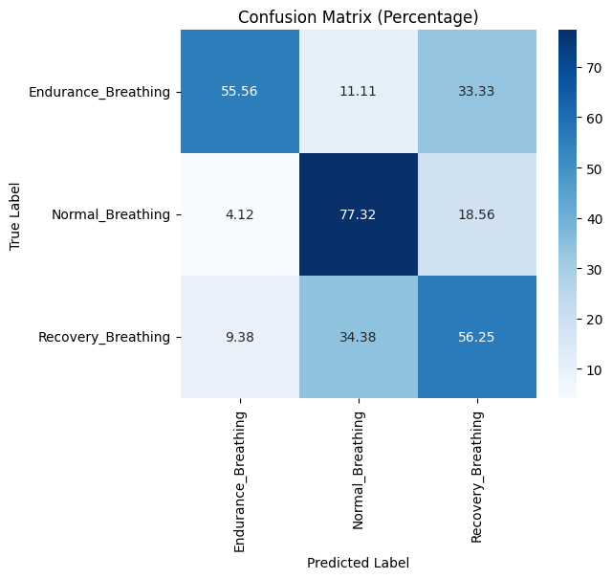
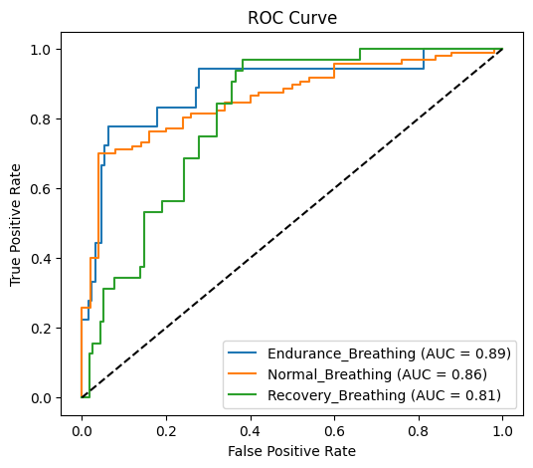
Work Done
Base Models-
Simple RNN –

Slide 15
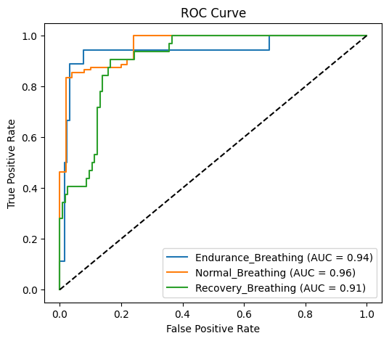
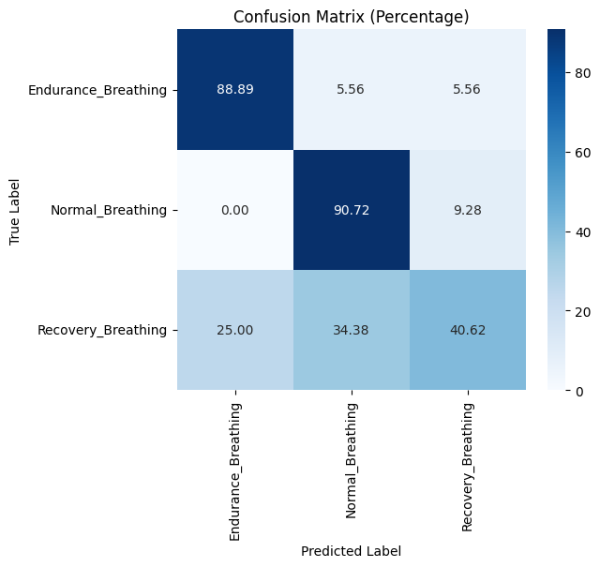
Work Done
Base Models-
LSTM –

Slide 16
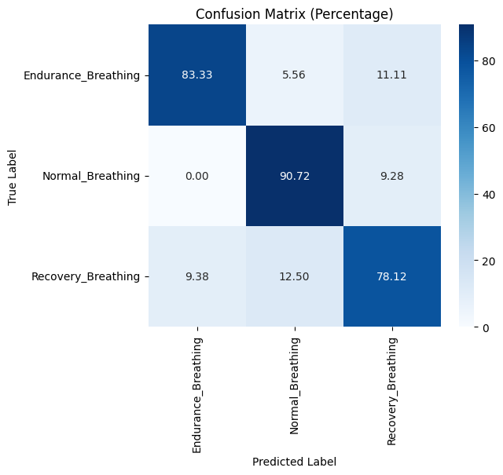
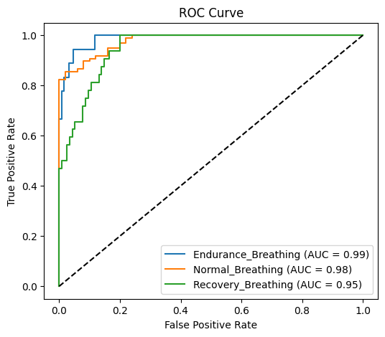
Work Done
Base Models-
GRU –

Slide 17
Customized model Framework
Input
Feature Extraction
Temporal Learning
CNN
LSTM
TRANSFORMER ENCCODER
Custom Attention Layer
Dense Layer
Output

Slide 18
Segmentation of Dataset:
→ For 30 secs and 15 Hz as sampling frequency we get 450 samples.
Input layer:
For this layer the shape given is 450 samples per segment for 6 channels (Multiple Channels)
Total segments are 244
The original shape is 109800, which is calculated by formula:
Os = total segments x one segment samples
where ,
Os → Original Shape
Os = 450 x 244 = 109800.

Slide 19
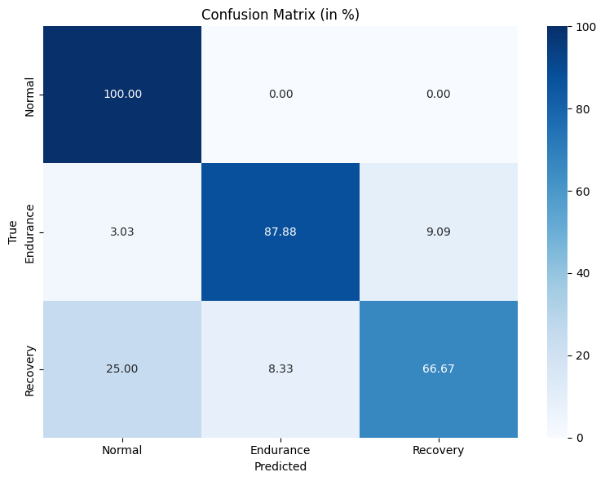
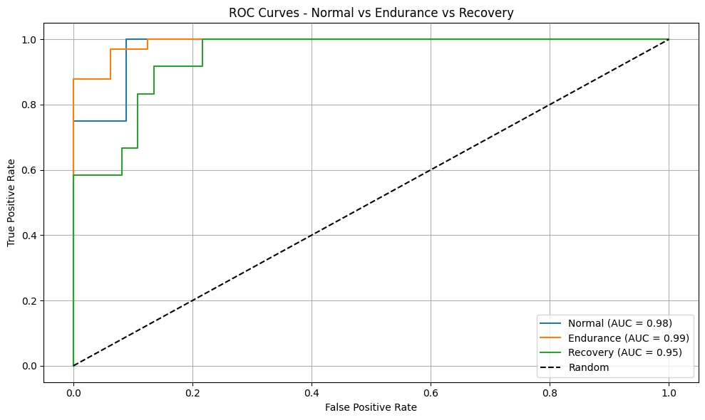
Customized model

Slide 20
Model Performance Metrics
Models | Loss | Accuracy | F1-Score | Support | Recall | Precision
Simple RNN Model | 1.E - 0.7392 2.N - 0.7392 3.R - 0.7392 | 1.E - 0.8143 2.N - 0.8543 3.R - 0.8643 | 1.E - 1.304 2.N - 0.8585 3.R - 0.2564 | 1.E -18 2.N - 97 3.R - 32 | 1.E - 0.5000 2.N - 0.9381 3.R - 0.1562 | 1.E - 0.8040 2.N - 0.7913 3.R - 0.7143
LSTM Model | 1.E - 0.4657 2.N - 0.4657 3.R - 0.4657 | 1.E - 0.8503 2.N - 0.8503 3.R - 0.8503 | 1.E - 0.7143 2.N - 0.9175 3.R - 0.7222 | 1.E - 18 2.N - 97 3.R - 32 | 1.E - 0.5556 2.N - 0.9175 3.R - 0.8125 | 1.E - 1.0000 2.N - 0.9175 3.R - 0.6500
GRU Model | 1.E - 0.4051 2.N - 0.4051 3.R - 0.4051 | 1.E - 0.8231 2.N - 0.8231 3.R - 0.8231 | 1.E - 0.7879 2.N - 0.8936 3.R - 0.6575 | 1.E - 18 2.N - 97 3.R - 32 | 1.E - 0.7222 2.N - 0.8660 3.R - 0.7500 | 1.E - 0.8667 2.N - 0.9231 3.R - 0.5854
Customized Model | 1.E - 0.0017 2.N - 0.1323 3.R - 0.8583 | 1.E - 1.0000 2.N - 0.9091 3.R - 0.7500 | 1.E - 0.6667 2.N - 0.9524 3.R - 0.7826 | 1.E - 4 2.N - 33 3.R - 12 | 1.E - 1.0000 2.N - 0.9091 3.R - 0.7500 | 1.E - 0.5000 2.N - 1.0000 3.R - 0.8182

Slide 21
Calculation
→Eg for simple RNN:
Accuracy = (TP +TN)/(TP+FN+FP+TN)
TP = 55.56 , FN = 44.44 , FP = 13.5 , TN = 186.51 FROM Confusion Matrix.
Therefore the Accuracy is 0.806.
Precision = (TP)/(TP+FP)
Therefore The Precision value is 0.804
Recall = (TP)/(TP+FN)
Therefore the Recall value is 0.5000
4. F1 Score = (2 * Precision * Recall)/(precision + recall)
Therefore the F1 score value is

Slide 22
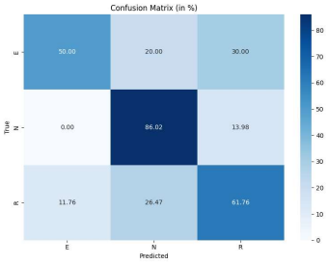
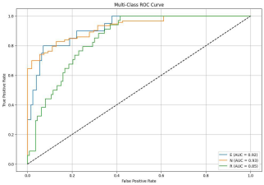
CNN and LSTM –

Slide 23
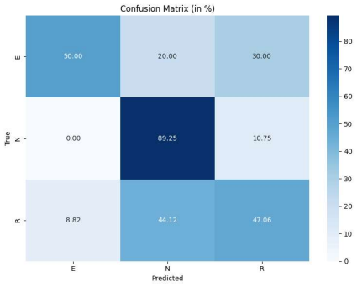
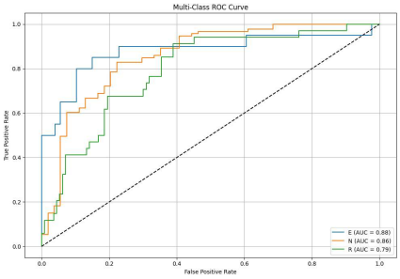
LSTM AND TRANSFORMER

Slide 24
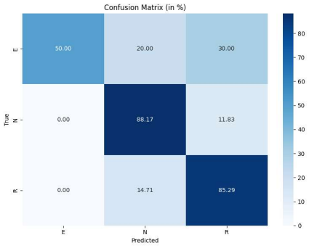
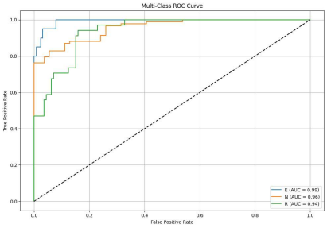
CNN AND TRANSFORMER:

Slide 25
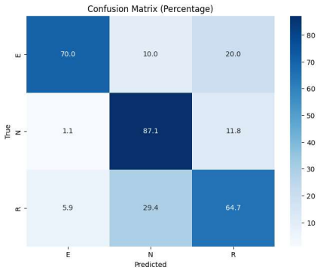
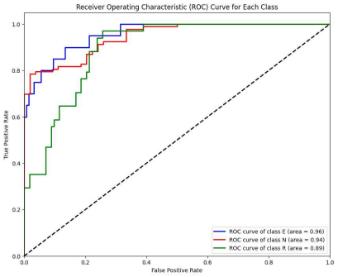
Customized Model

Slide 26
CONCLUSION
The Customized Model demonstrates superior performance over the CNN+LSTM, LSTM+Transformer, and CNN + Transformer models across almost all evaluation metrics. It provides better overall accuracy, higher AUC scores, and more balanced classification across Endurance, Normal, and Recovery breathing patterns. This makes it the most reliable and robust choice for multi-class breathing pattern classification.
Metric | Class E (Endurance) | Class N (Normal) | Class R (Recovery)
Precision | 0.91 | 0.69 | 0.67
Recall | 0.70 | 0.87 | 0.65
F1 Score | 0.79 | 0.77 | 0.66
Accuracy | 0.87 | 0.82 | 0.77
AUC | 0.96 | 0.94 | 0.89

Slide 27
REFERENCES
[1]. Fabrication of ZnO thin film-based humidity sensor with fast response by sol-gel associated to spin coating method Ghanem salah 1, A.Telia 1 and C.Boukaous 1 1Department of electronic, Laboratory of Microsystems and instrumentation (LMI) University of Constantine 1, Constantine, Algeria IEEE April 10,2024.
[2]. A Review of Zinc Oxide (Zno) Nanostructure Based Humidity Sensor Shahirah Ahmad Kamal1, Nor Diyana Md Sin2,*, Mohamad Hafiz Mamat1, Mohamad Zhafran Hussin2, Noor Asnida Asli3 and Mohd Firdaus Malek3 1NANO-ElecTronic Centre (NET), School of Electrical Engineering, College of Engineering, Universiti Technologies MARA, 40450 Shah Alam, Selangor, Malaysia 2Centre for Electrical Engineering Studies, University Technologies MARA (UiTM), Cadangan Johor Kampus Pasir Gudang 81750 Masai, Johor, Malaysia 3NANO-SciTech Lab, Functional Materials and Nanotechnology Centre, Institute of Science, Universiti Teknologi MARA, 40450 Shah Alam, Selangor, Malaysia Int. J. Nanoscience Nanotechnology., Vol. 19, No. 2, June 2023, pp. 85-95.
[3]. Optical Humidity Sensor Based on ZnO Nanomaterials Haolin Li, Bingheng Meng, Huimin Jia, Dengkui Wang, Zhipeng Wei State Key Laboratory of High Power Semiconductor Laser Changchun University of Science and Technology Changchun 130022, P. R. China , Ruxue Li, Rui Chen Department of Electrical and Electronic Engineering Southern University of Science and Technology Shenzhen 518055, P. R. China 2020 the 5th Optoelectronics Global Conference.
[4]. Paper-based Humidity Sensor Coated with ZnO Nanoparticles: The Influence of ZnOG. Niarchosa,*, G. Dubourga, G. Afroudakisb, V. Tsoutib, E. Makaronab, J. Matovi Crnojevi-Bengina, C. Tsamisb a BioSense Institute, 1 Zorana Djindijca, Novi Sad 21000, Serbia b a, V. Institute of Nanoscience and Nanotechnology, National Center for Scientific Research “Demokritos”, Patriarhou Gregoriou & Neapoleos, Aghia Paraskevi 15310, Athens, Greece 30th Eurosensors Conference, EUROSENSORS 2016.

Slide 28
THANK YOU

